Slide 1





The Demoscene on Android
Becoming - A Demo for Breakpoint 2010
irata ^ TRSI
spotter ^ TRSI
bodo ^ RAB
eyebex ^ BC

Slide 2

What is the Demoscene?
Computer art sub-culture
Roots in Warez-Scene (“Cracktros”)
Non-interactive audio-visual presentations (“intros”, “demos”) that run in real-time
Programmers, musicians, artists team up and compete at Demoparties
Platforms include PC, Amiga, C64 as well as PS3, Xbox, NDS and homebrewn hardware

Slide 3
The Motivation
Do something cool with our smartphones
Android is OSS and the SDK is free
Samsung Galaxy, HTC Hero, Motorola Milestone
Conquer a new platform (“firstie”)
Appreciation and respect in the Demoscene
Congratulate Irata to TRSI‘s 20th birthday
Red Sector Inc. was already founded in 1985

Slide 4
The Team
Gather know-how from different groups
spotter ^ TRSI: Graphics and design
bodo ^ Rabenauge: Mobile coding
eyebex ^ Brain Control: OpenGL coding
Ralf Wadephul: Music

Slide 5
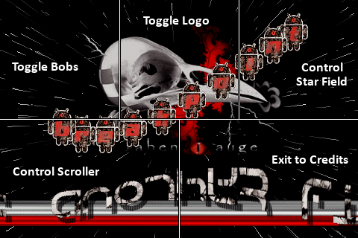
The Idea
Old-school style, not just usual 3D stuff
Sensors: Make it interactive

Slide 6
What did we learn? (1)
GPU performance rather bad
Anyone sponsor us with recent Android phones?
Non-zero position in gl*Pointer() buffer makes some implementations crash
Use slice() instead
glu(Un)Project() unusable without OES_matrix_get
Need to track matrices on GPU and CPU due to missing glLoadMatrix()

Slide 7
What did we learn? (2)
OpenGL bugs
Smooth points are aliased
Invalid parameters are accepted, e.g. glColorPointer(3,…)
Android bugs
Sensor.TYPE_ALL does not work as Sensor.TYPE_* are not powers of two

Slide 8
References
Para ´N´ droiD
http://www.pouet.net/prod.php?which=54560
Demoscene
http://en.wikipedia.org/wiki/Demoscene
http://www.demoscene.info/
http://www.elektrischer-reporter.de/elr/video/85/
http://www.3sat.de/page/?source=/neues/sendungen/magazin/143524/index.html
Demoparties
http://breakpoint.untergrund.net/
http://www.demoparty.net/
Android
http://blog.jayway.com/2009/12/03/opengl-es-tutorial-for-android-part-i/
http://www.androidguys.com/2009/01/30/projecting-android-on-the-big-screen/

